Slide 1
Lecture 6: Estimating Demand Functions with Travel Cost Models
Prof. Parthum
Environmental Economics Econ 475

Slide 2
The Travel Cost Model
In June of 1947, the National Parks Service, headed by Arthur Demaray, reached out to a group of economists to ask about the feasibility of estimating the economic value of the national park system.

Slide 3
The Travel Cost Model
In June of 1947, the National Parks Service, headed by Arthur Demaray, reached out to a group of economists to ask about the feasibility of estimating the economic value of the national park system.
In response they received 10 letters. One of these letters was from Harold Hotelling.

Slide 4
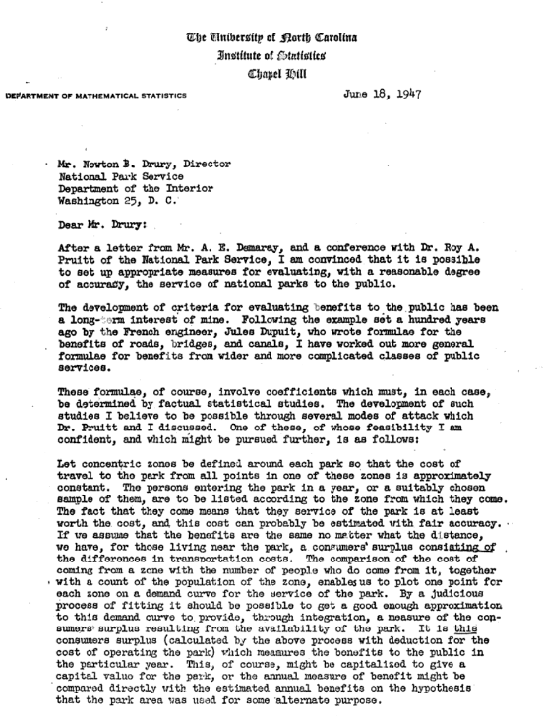
The Travel Cost Model
In June of 1947, the National Parks Service, headed by Arthur Demaray, reached out to a group of economists to ask about the feasibility of estimating the economic value of the national park system.
In response they received 10 letters. One of these letters was from Harold Hotelling.

Slide 6

The Travel Cost Model
$$V_{ijt} = λcost_{ijt} + βX + φ +{ ε}_{ijt}$$

Slide 7





The Travel Cost Model
$$V_{ijt} = λcost_{ijt} + βX + φ +{ ε}_{ijt}$$
$$=$$
$$+$$
$$+$$
$+ ?$

Slide 8

The Travel Cost Model
$$V_{ijt} = λcost_{ijt} + βX + φ +{ ε}_{ijt}$$
$$=$$
$$+$$
$$+$$
$+ ?$

Slide 9

The Travel Cost Model
$$V_{ijt} = λcost_{ijt} + βX + φ +{ ε}_{ijt}$$
$$=$$
$$+$$
$$+$$
$+ ?$

Slide 10




The Travel Cost Model
$$V_{ijt} = λcost_{ijt} + βX + φ +{ ε}_{ijt}$$
$$=$$
$$+$$
$$+$$
$+ ?$

Slide 11

The Travel Cost Model
$$V_{ijt} = λcost_{ijt} + βX + φ +{ ε}_{ijt}$$
$$=$$
$$+$$
$$+$$
$+ ?$

Slide 12

The Travel Cost Model
$$V_{ijt} = λcost_{ijt} + βX + φ +{ ε}_{ijt}$$
$$=$$
$$+$$
$$+$$
$+ ?$

Slide 13

The Travel Cost Model
$$V_{ijt} = λcost_{ijt} + βX + φ +{ ε}_{ijt}$$
$$=$$
$$+$$
$$+$$
$+ ?$

Slide 14

The Travel Cost Model
$$V_{ijt} = λcost_{ijt} + βX + φ +{ ε}_{ijt}$$
$$=$$
$$+$$
$$+$$
$+ ?$

Slide 15







The Travel Cost Model
$$V_{ijt} = λcost_{ijt} + βX + φ +{ ε}_{ijt}$$
$$=$$
$$+$$
$$+$$
$+ ?$
$$=$$
$$+$$
$$+$$
$+ ?$

Slide 16
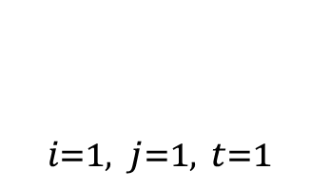
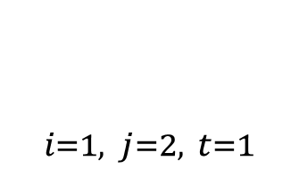
The Travel Cost Model
$$V_{ijt} = λcost_{ijt} + βX + φ +{ ε}_{ijt}$$
$$=$$
$$+$$
$$+$$
$+ ?$
$X_{i=1, j=1, t=1}$
$$=$$
$$+$$
$$+$$
$+ ?$
$X_{i=1, j=2, t=1}$

Slide 17
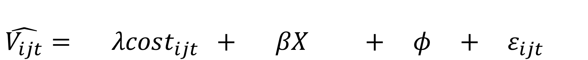

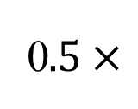
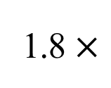
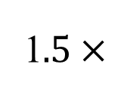

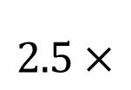
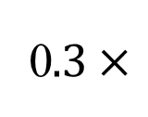

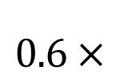
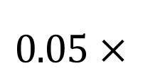

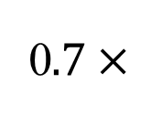
The Travel Cost Model
$$\hat{V_{ijt}}= λcost_{ijt} + βX + φ +{ ε}_{ijt}$$
1$.5×$
$$2.5×$$
$$35.1×$$
1.8 $×$
$$+$$
$$+$$
$$0.05×$$
0$.5×$
0$.7×$
$$15.2×$$
$$0.6×$$
0$.3×$

Slide 18
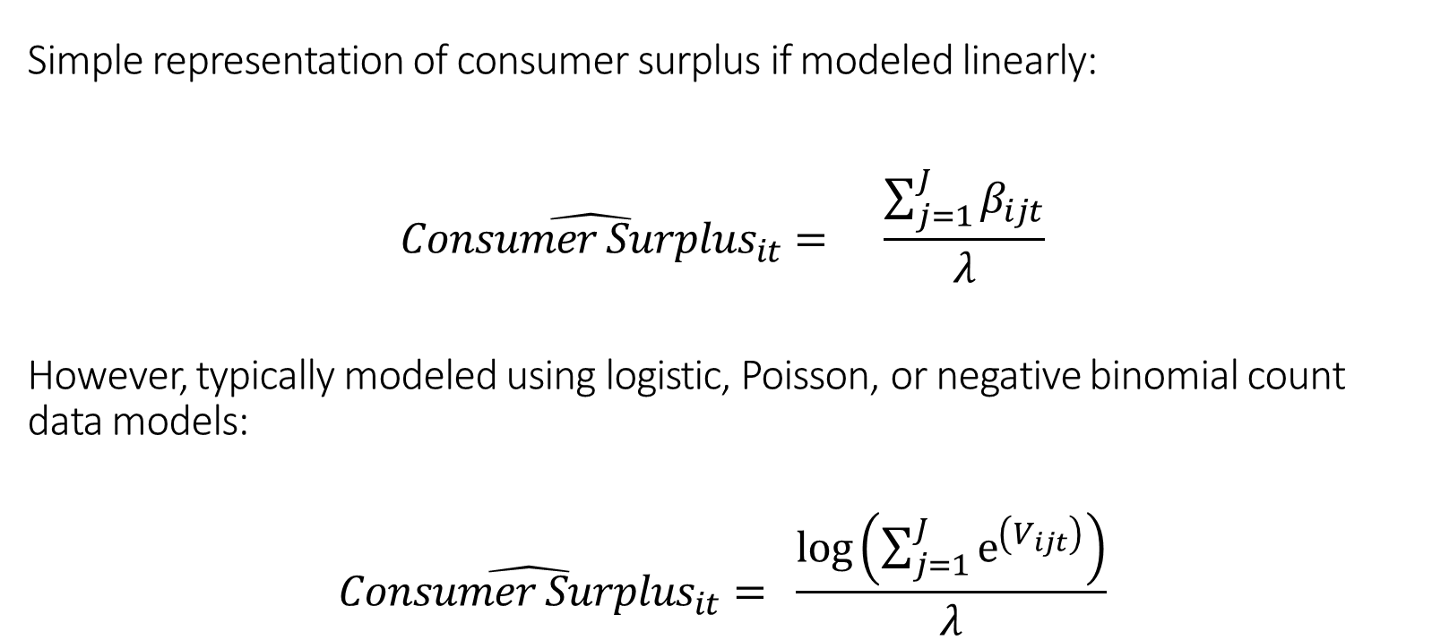
The Travel Cost Model
Simple representation of consumer surplus if modeled linearly:
$$\hat{{Consumer Surplus}_{it}}= \frac{\sum_{j=1}^{J}{β_{ijt}}}{λ}$$
However, typically modeled using logistic, Poisson, or negative binomial count data models:
$$\hat{{Consumer Surplus}_{it}}= \frac{log\left(\sum_{j=1}^{J}{e^{\left(V_{ijt}\right)}}\right)}{λ}$$

Slide 19
Valuing urban open space using the travel-cost method and the implications of measurement error (here)
By: Hanauer and Reid (2017)
Research Questions:
What is the value of Taylor Mountain Regional Park in Santa Rosa, California?
Approximately $13.70 per trip for
Can using individual-specific travel cost estimates improve estimation?
They find evidence that using conventional methods could potentially understate the value of the regional park.

Slide 20
Valuing urban open space using the travel-cost method and the implications of measurement error (here)
By: Hanauer and Reid (2017)
Research Questions:
What is the value of Taylor Mountain Regional Park in Santa Rosa, California?
Approximately $13.70 per trip, or $1.5mil each year
Can using individual-specific travel cost estimates improve estimation?
They find evidence that using conventional methods could potentially understate the value of the regional park.

Slide 21
Valuing urban open space using the travel-cost method and the implications of measurement error (here)
By: Hanauer and Reid (2017)
Data:
439 intercept surveys
Number of trips, costs, where they live, how they got there, if they paid for parking, income, demographics, etc.
Average number of self reported trips in the past year 32.8

Slide 22
Valuing urban open space using the travel-cost method and the implications of measurement error (here)
By: Hanauer and Reid (2017)
Data:
439 intercept surveys
Number of trips, costs, where they live, how they got there, if they paid for parking, income, demographics, etc.
Average number of self reported trips in the past year 32.8
How were costs calculated?

Slide 23
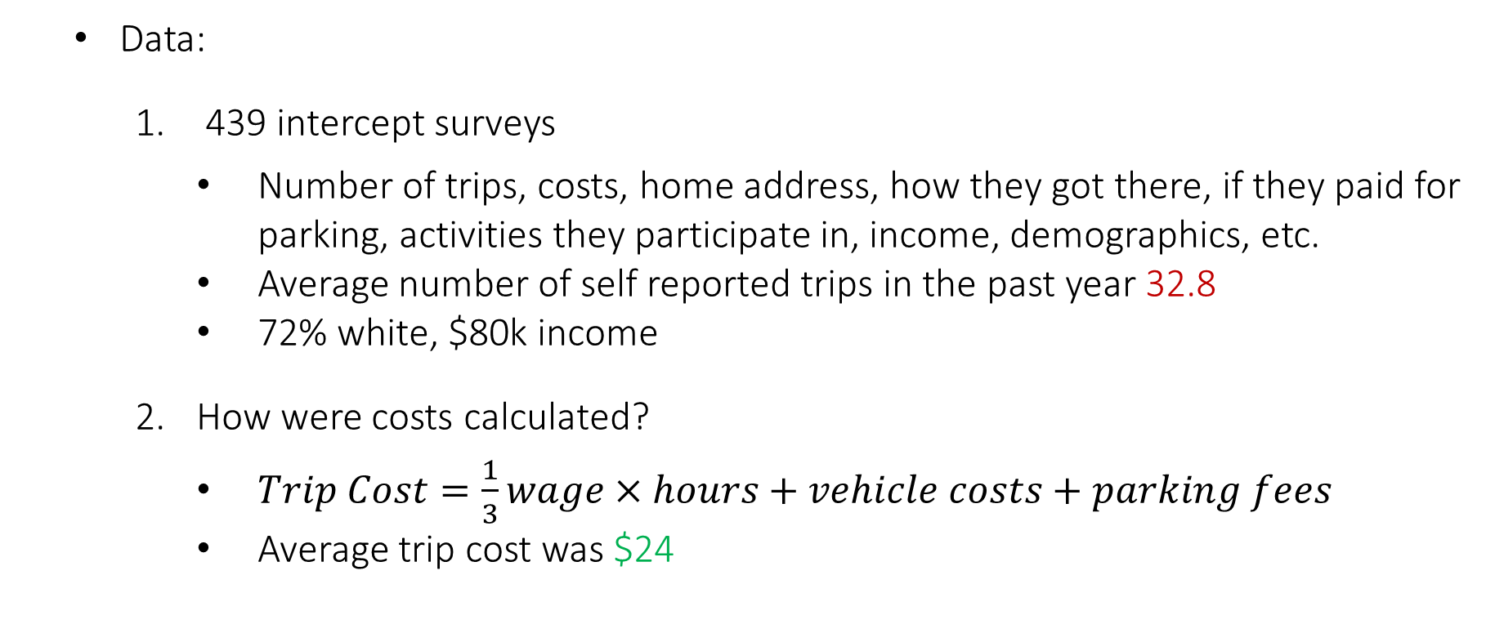
Valuing urban open space using the travel-cost method and the implications of measurement error (here)
By: Hanauer and Reid (2017)
Data:
439 intercept surveys
Number of trips, costs, home address, how they got there, if they paid for parking, activities they participate in, income, demographics, etc.
Average number of self reported trips in the past year 32.8
72% white, $80k income
How were costs calculated?
$Trip Cost=\frac{1}{3}wage×hours+vehicle costs+parking fees$
Average trip cost was $24

Slide 24
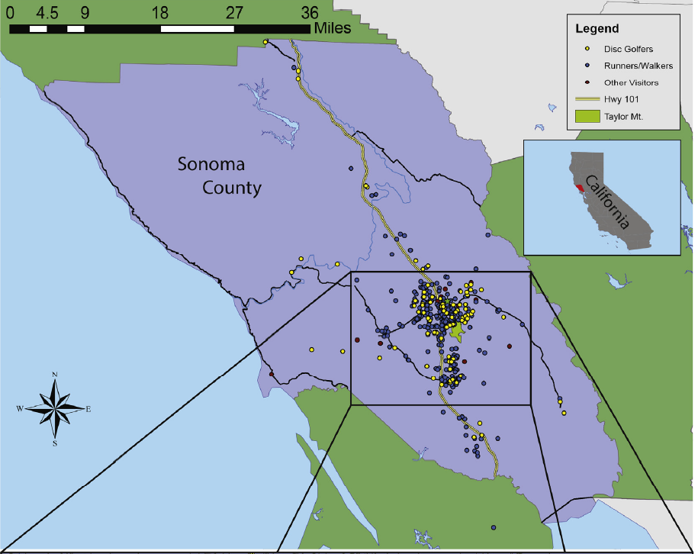
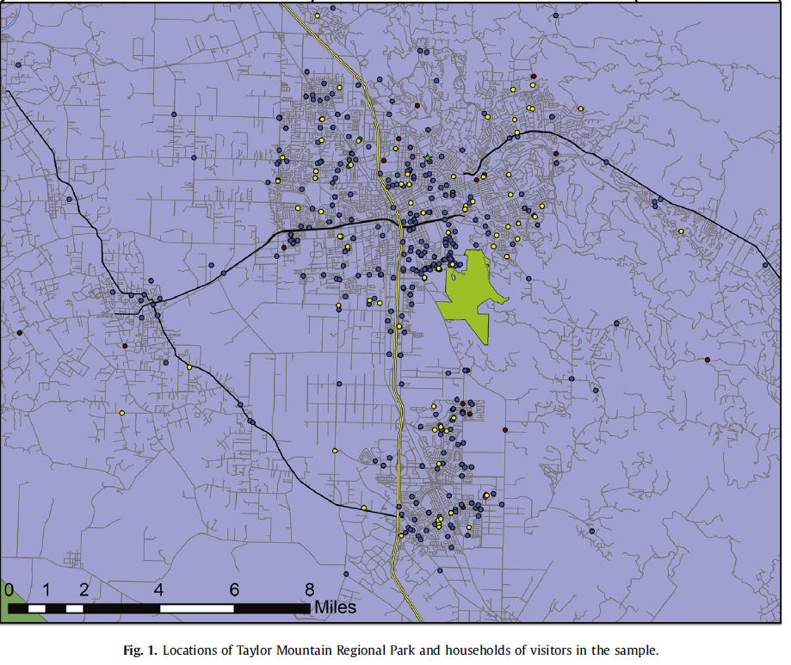

Slide 25
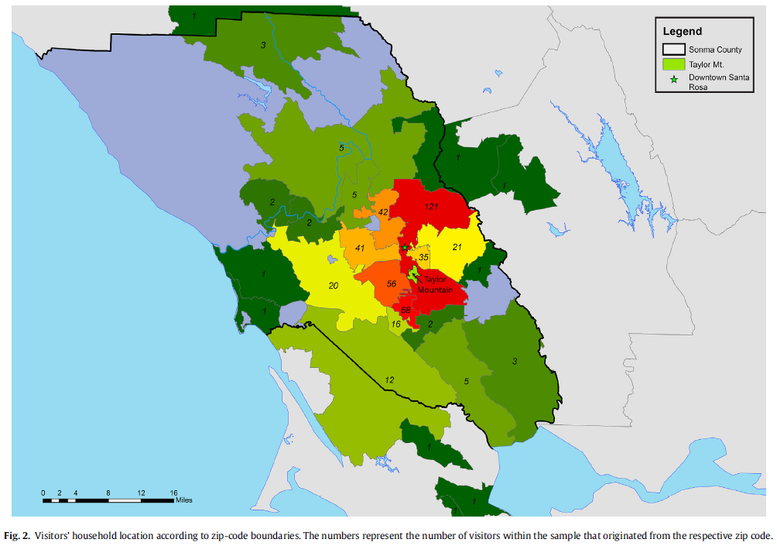

Slide 26
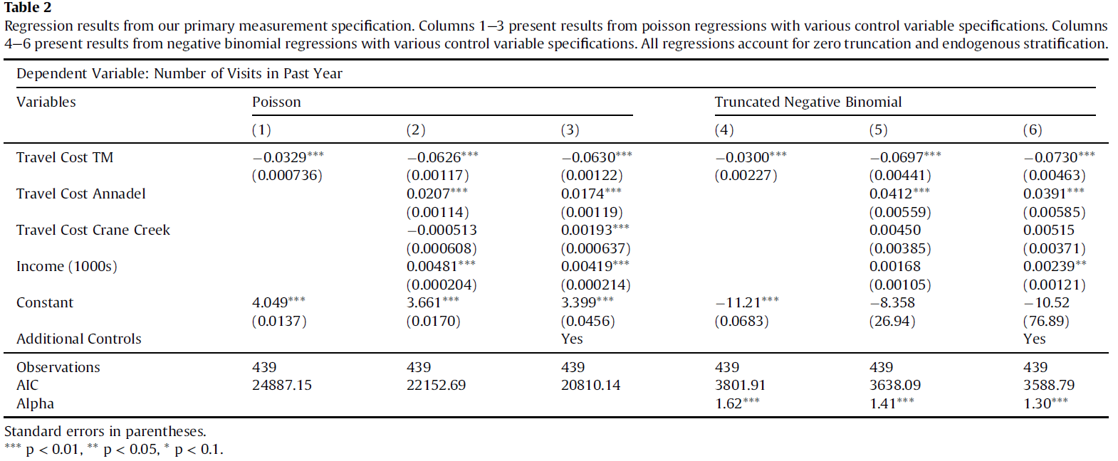
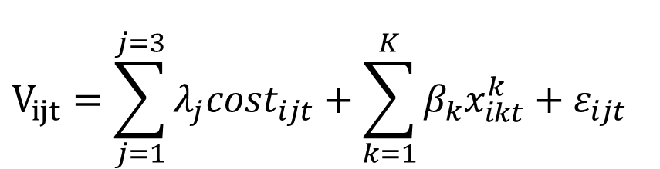
$$V_{ijt}=\sum_{j=1}^{j=3}{λ_{j}cost_{ijt}}+\sum_{k=1}^{K}{β_{k}x_{ikt}^{k}}+ε_{ijt}$$

Slide 27
$$V_{ijt}=\sum_{j=1}^{j=3}{λ_{j}cost_{ijt}}+\sum_{k=1}^{K}{β_{k}x_{ikt}^{k}}+ε_{ijt}$$

Slide 28
$$V_{ijt}=\sum_{j=1}^{j=3}{λ_{j}cost_{ijt}}+\sum_{k=1}^{K}{β_{k}x_{ikt}^{k}}+ε_{ijt}$$

Slide 29
$$V_{ijt}=\sum_{j=1}^{j=3}{λ_{j}cost_{ijt}}+\sum_{k=1}^{K}{β_{k}x_{ikt}^{k}}+ε_{ijt}$$

Slide 30
$$V_{ijt}=\sum_{j=1}^{j=3}{λ_{j}cost_{ijt}}+\sum_{k=1}^{K}{β_{k}x_{ikt}^{k}}+ε_{ijt}$$

Slide 31
$$V_{ijt}=\sum_{j=1}^{j=3}{λ_{j}cost_{ijt}}+\sum_{k=1}^{K}{β_{k}x_{ikt}^{k}}+ε_{ijt}$$

Slide 32
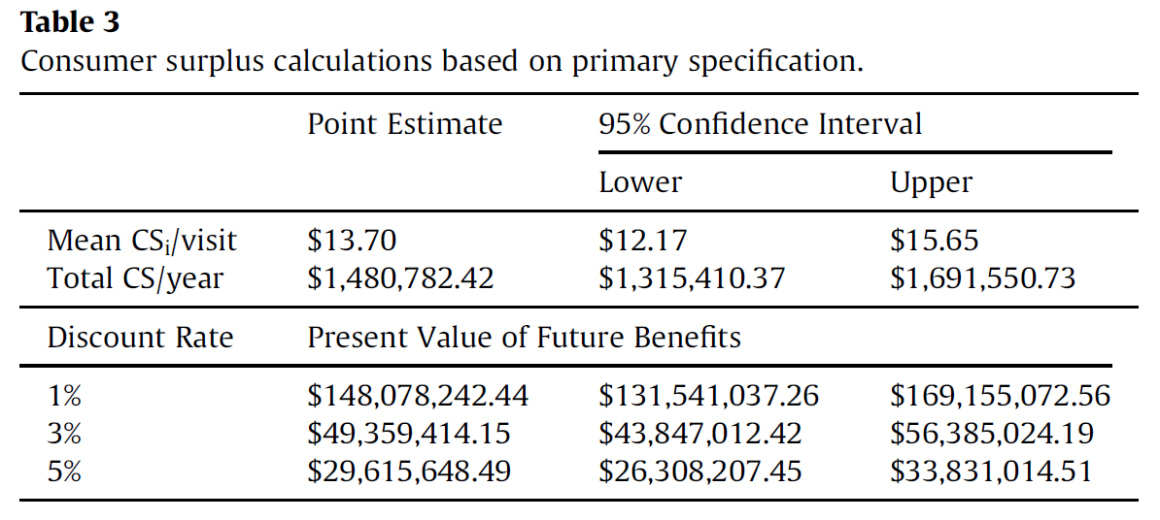
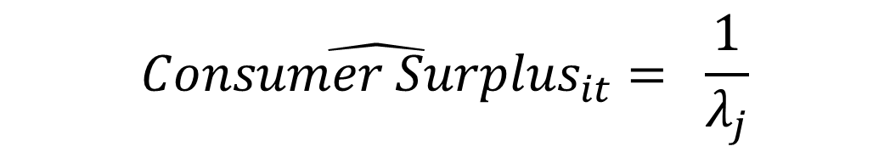
$$\hat{{Consumer Surplus}_{it}}= \frac{1}{λ_{j}}$$

Slide 33
$$\hat{{Consumer Surplus}_{it}}= \frac{1}{λ_{j}}$$

Slide 34
$$\hat{{Consumer Surplus}_{it}}= \frac{1}{λ_{j}}$$

Slide 35
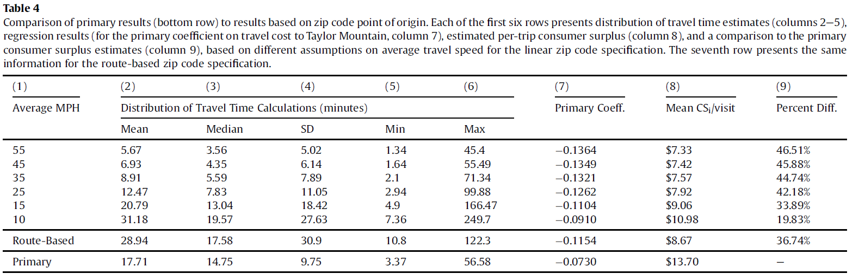
Does using zip-code level data to estimate travel costs bias the results?
The authors find that by failing to account for within-zip-code variation in travel costs the per trip consumer surplus and, thus, the overall benefits of Taylor Mountain Regional Park are underestimated compared to when more accurate individual-level costs are used.

Slide 36
Next class
Hedonics:
Two papers:
Kuwayama et al. (2022)
Christensen and Timmins (2021)
Case Study due Sept 25th by 11:59pm
Estimate a travel cost or hedonic model.
Data and code (or at least most of it) will be provided.
Your job will be to submit a writeup of your results, explain the intuition, any potentially missing information/data that you would have like to have included in the analysis.
You will also submit your code.

